Slide 1
Project Progress
28 Apr 2026

Slide 2
Progress
Renamed dataset names so that serial 32 all ends with ‘_baseline’
Renamed dataset names in serial 39 with ‘_pt_siglipv2 or ‘_pt_ig1b’ to ‘_pl’
Renamed model names so that all of them has the ‘hi’ prefix
Moved all soylocal runs from serial 32 & 39 to serial 54
Made pseudo-hierarchy overview pipeline
Made Soylocal heatmap

Slide 3
Serial Explanation
Serial 23 & 24, 25 & 27, 26 & 28: Original runs and transferability metrics(1312 runs)
  23 & 24: Original hierarchical runs, FT and FZ respectively. 21 models * 3 datasets * 10 LRs * 2 serials = 1260 runs
  25 & 27: CKA, Euclid. distance, L2 norm for original runs. 21 models * 3 datasets * 2 serials = 126 runs
  26 & 28: MSC, intra distance, inter distance for original runs. 21 models * 3 datasets * 2 serials = 126 runs
Serial 32 & 39: Pseudo-hierarchy related (
  32: Baseline (no hierarchy) runs.
    For air, cub, cars: 21 models * 3 datasets * 10 LRs = 630 runs.
  39: Pseudo-hierarchy runs.
    For air, cub, cars: 1 models * 3 datasets * 10 LRs * 7 ratios * 2 settings = 420 runs. (2 settings: IG1b extractor with IG1b run, Siglipv2 extractor with IG1b run)
Serial 35 & 36, 37 & 38, 30 & 31: Extra transferability metrics for hierarchy analysis(378 runs)
  35 & 36: CKA runs with intra & inter distances. 21 models * 3 datasets * 2 serials = 126 runs
  37 & 38: Same as previous set of serials, but these ones are for 2nd target. 21 models * 3 datasets * 2 serials = 126 runs
  30 & 31: MSC, intra distance, inter distance on 2nd target. 21 models * 3 datasets * 2 serials = 126 runs
Serial 208 & 209: Output of compute_features_norms.py
  208 & 209: Output of compute_features_norms.py, for analysis on why some models performs better or more robust. Only 11 runs listed, I think I only ran the best-2 and worst-2
Serial 33 & 34: Reruns of some models but with worse LR to see the effect in the layers (For feature visualization)
Serial 40: Pseudo-hierarchy runs on Aircraft, CUB, Cars with less ratio (25, 50, 70). 3 datasets * 21 models * 3 ratios * 10 LRs = 1890 runs

Slide 4
Serial Explanation
Serial 41: Pseudo-hierarchy runs of CLIP on CUB with different extractors. 1 dataset * 20 models * 10 LRs * 1 ratio = 200 runs
Serial 51: Pseudo-hierarchy runs of Deit3 on Aircraft with different extractors. 1 dataset * 20 models * 10 LRs * 1 ratio = 200 runs
Serial 62 & 63, 64 & 65, 66 & 67, 68 & 69: Comparison of baseline vs pseudo with different hparams with Deit3 on Aircraft (124 runs)
  62 & 63: Baseline vs pseudo with different batch_sizes. 10 batch_sizes * 2 comparison = 20 runs
  64 & 65: Baseline vs pseudo with different epochs. 10 epochs * 2 comparison = 20 runs
  66 & 67: Baseline vs pseudo with different image_sizes. 10 image_sizes * 2 comparison = 20 runs
  68 & 69: Baseline vs pseudo with different augmentations. 12 augs * 2 comparison = 24 runs
  70: Baseline vs pseudo with different model_sizes. 4 model_sizes * 10 lrs = 40 runs
Serial 42 & 43, 44 & 45, 46 & 47, 48 & 49: Comparison of baseline vs pseudo with different hparams with CLIP on CUB (84 runs)
  42 & 43: Baseline vs pseudo with different batch_sizes. 10 batch_sizes * 2 comparison = 20 runs
  44 & 45: Baseline vs pseudo with different epochs. 10 epochs * 2 comparison = 20 runs
  46 & 47: Baseline vs pseudo with different image_sizes. 10 image_sizes * 2 comparison = 20 runs
  48 & 49: Baseline vs pseudo with different augmentations. 12 augs * 2 comparison = 24 runs
Serial 52 & 53: Runs of pseudo with other clustering algorithm (kmeans & agglomerative) (20 runs)
Serial 54: Runs with other dataset, Soylocal, move it here (21 models * 7 ratios * 10 lrs = 1470 pseudo + 210 baseline = 1680 runs)

Slide 5
Serial Explanation
Serial 56 - 61: Various runs with different models, datasets, settings using best learning rates
  Serial 56: Soylocal baseline
  Serial 57: Soylocal pseudo w/ 90% ratio
  Serial 58: Aircraft real hierarchy
  Serial 59: Aircraft baseline
  Serial 60: Aircraft, CUB, Cars frozen w/ hierarchy
  Serial 61: CUB frozen baseline (no hierarchy)
Serial 81 - 86: Various experiments regarding other leaves datasets, they are: Cotton. SoyGlobal, SoyGene, SoyAgeing, SoyAgeing_R*
  Serial 81: Using train:val split 80:20 for train and eval respectively, for baseline setting
  Serial 82: Using train:val split 80:20 for train and eval respectively, for pseudo-hierarchy setting
  Serial 84: Using train_val:test for train and eval respectively, for pseudo-hierarchy but with 3 different seeds (1, 10, 100) and best learning rate
  Serial 85: Using train_val:test for train and eval respectively, for baseline but with 3 different seeds (1, 10, 100) and best learning rate
  Serial 83: Using train_val:test for train and eval respectively, for baseline setting
  Serial 86: Using train_val:test for train and eval respectively, for pseudo setting

Slide 6
Serial Explanation
Serial 102 & 103: Few example experiments w/ 3 examples: 1,3,5 img per cls, w/ Aircraft
  Serial 102: Few examples baseline experiments
  Serial 103: Few examples real hierarchy experiments
Serial 91 - 94: Same class mix & hierarchical label smoothing experiments w/ Soylocal & Cotton dataset w/ 90% ratio
  Serial 91: Pseudo-hierarchy w/ same class mix on target 1
  Serial 92: Pseudo-hierarchy w/ hierarchical label smoothing
  Serial 93: Pseudo-hierarchy w/ same class mix on target 1 and hierarchical label smoothing
  Serial 94: Baseline w/ label smoothing

Slide 7
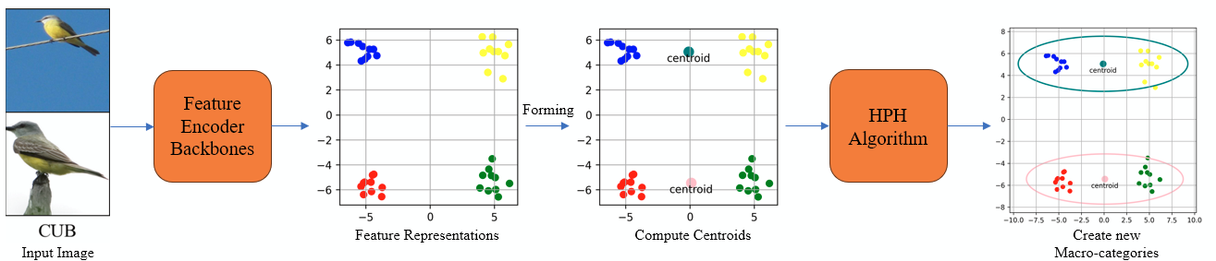
Pseudo-Hierarchy Overview Pipeline
Starts with input image which will be fed into Feature Encoder Backbone for feature extraction tensor
Feature tensor of (K, C) will be organized to (K, L), where L is number of fine-labels
First, we compute the centroids of each class, these centroids will be used to create macro-categories using the HPH algorithm
Unorganized macro-categories will be mapped back to the fine-classes
Notes:
K = number of images
C = number of channel

Slide 8
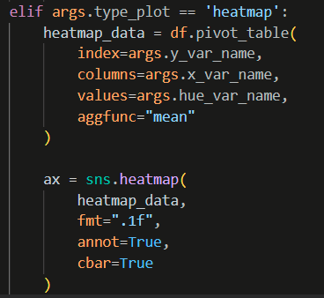
Soylocal heatmap
Modified plot.py to add type_plot = heatmap to make the heatmap using seaborn

Slide 9
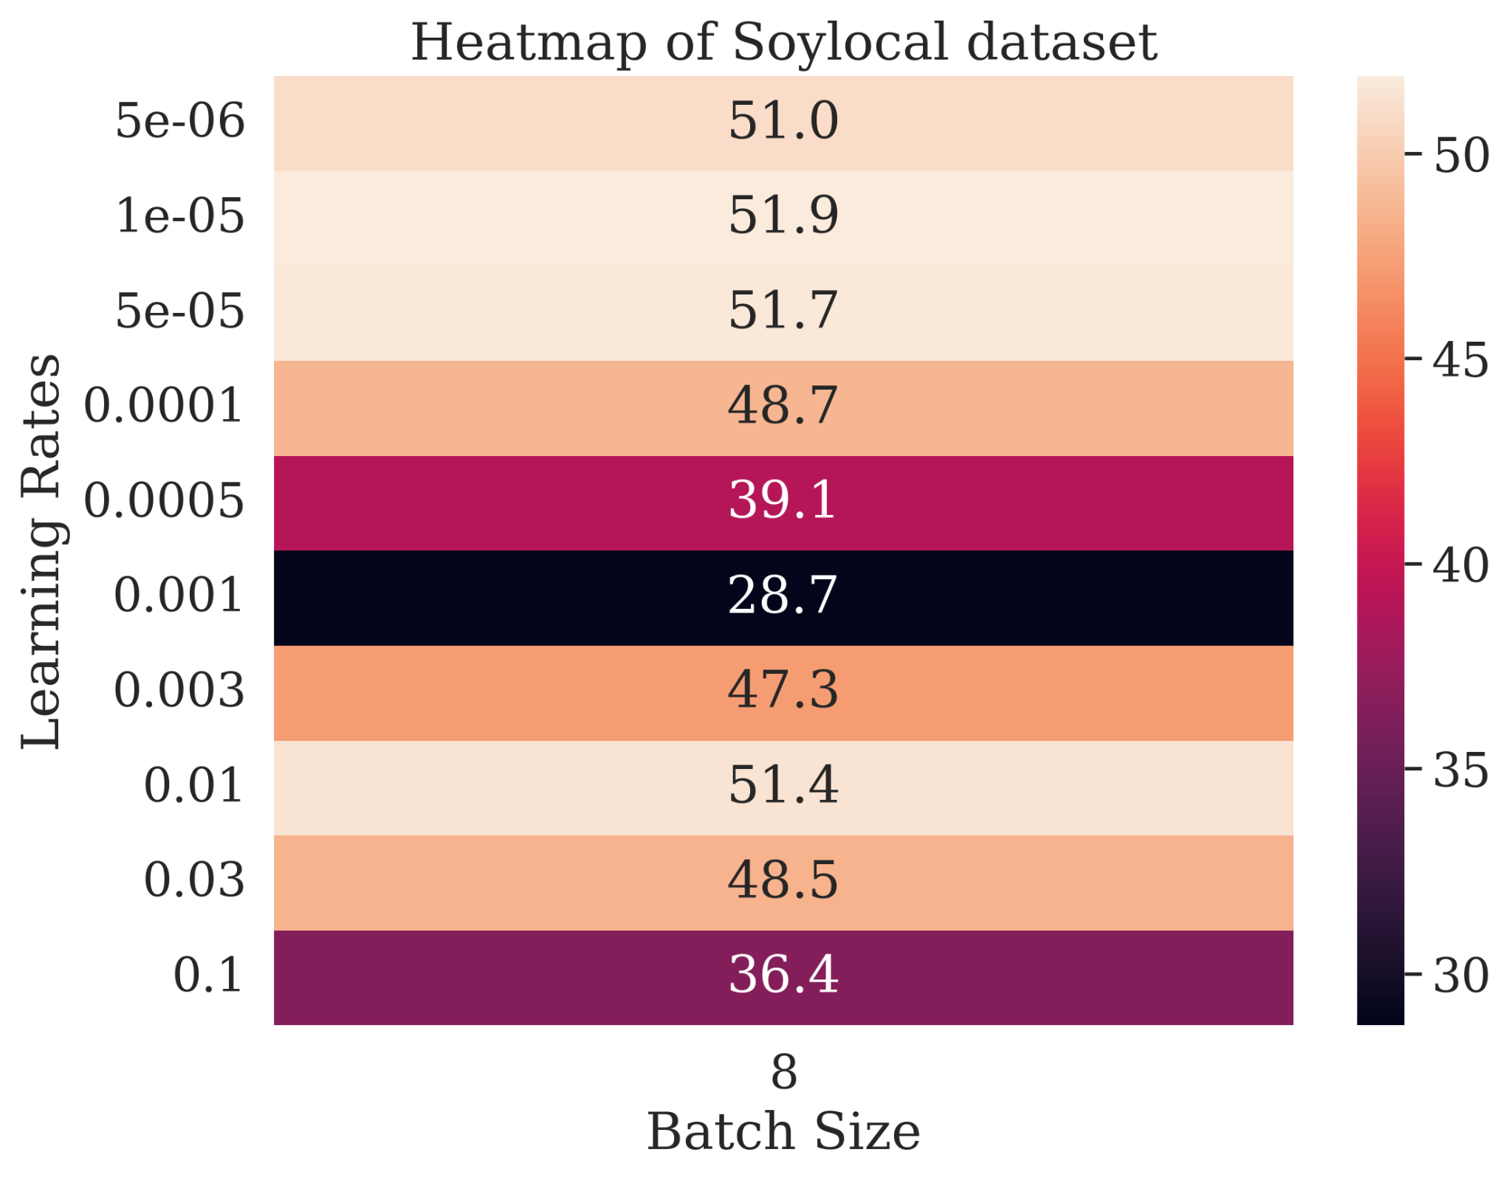
Soylocal heatmap
Highest mean accuracy is obtained at lr=1e-05, and second best at lr=0.01
Ideal lr is usually around the middle accuracy in each optimizer
Higher lr in each optimizer obtained terrible accuracy, consistent result from other dataset too
Notes:
It’s better in vertical :/

Slide 10
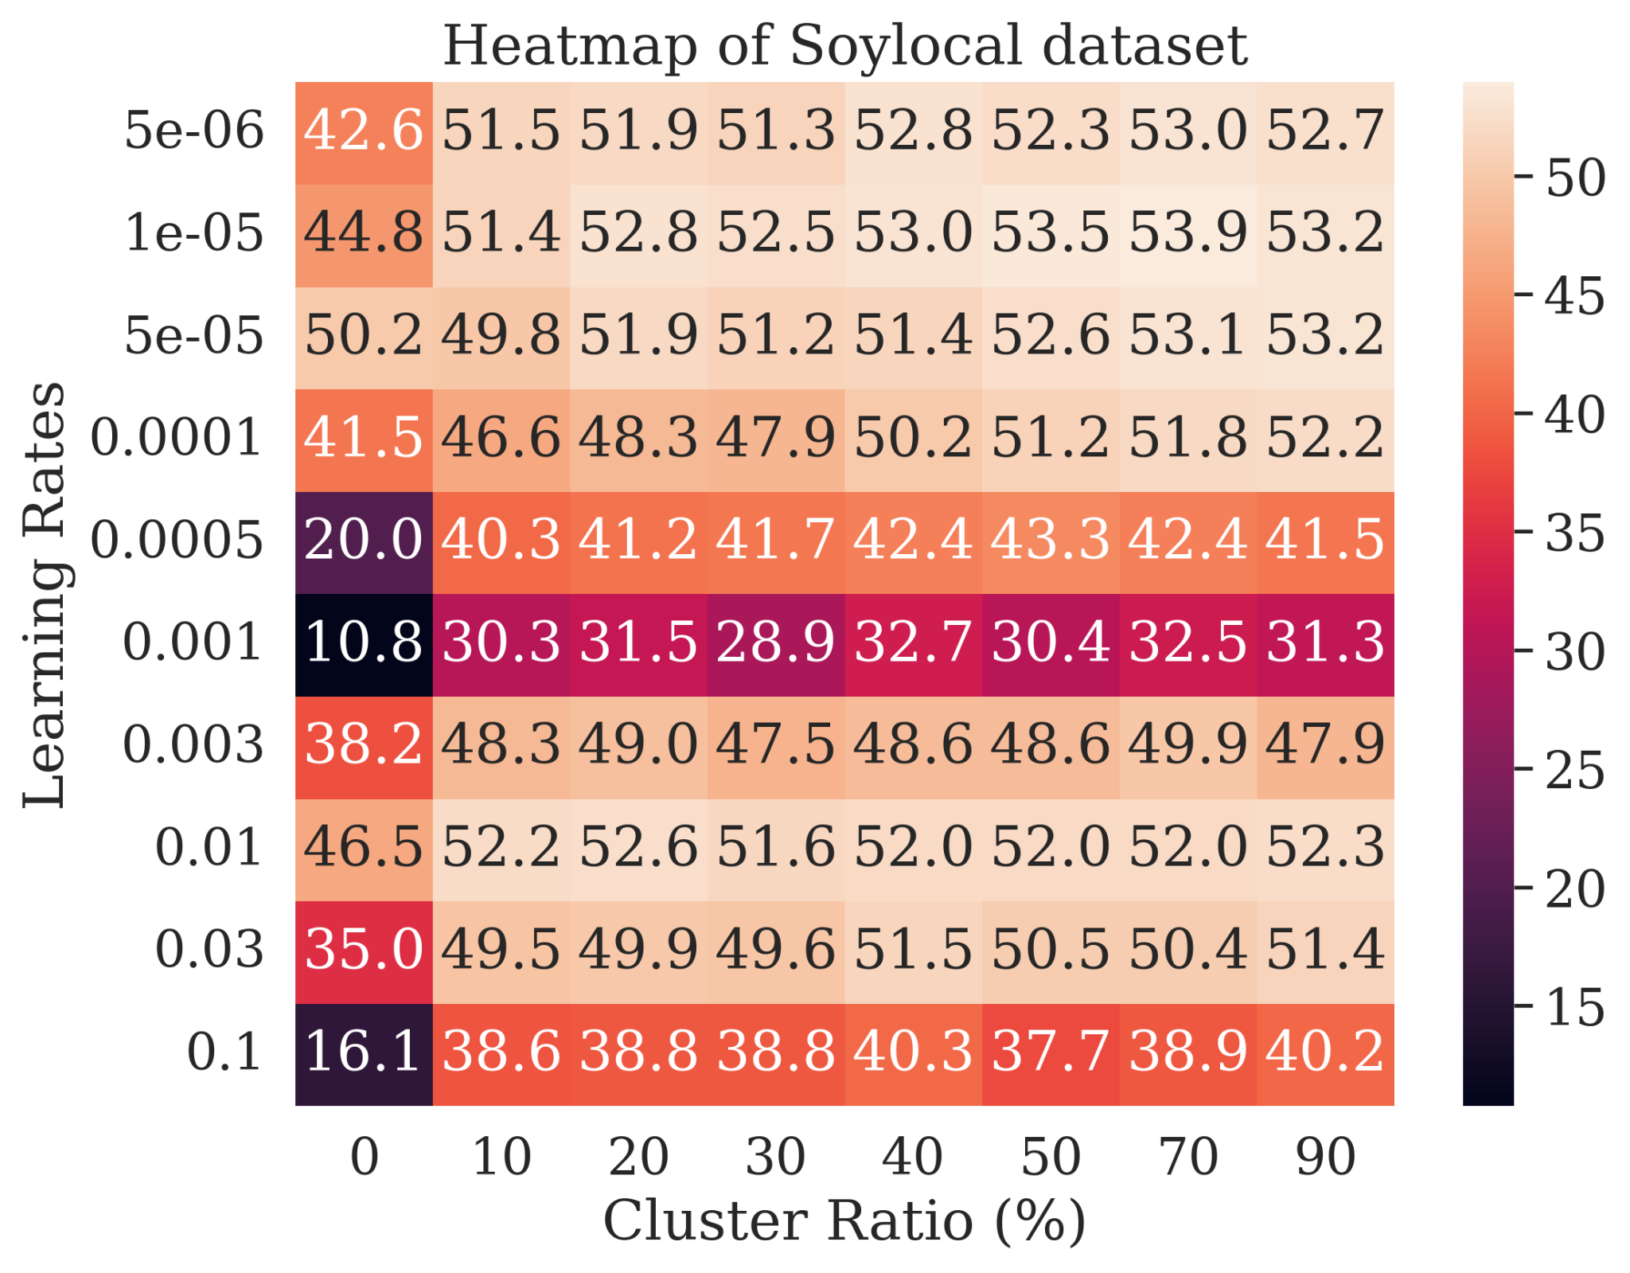
Soylocal heatmap
Other tha lr=5e-05, baseline for Soylocal consistently obtains lower results
Higher cluster ratios, such as 70 or 90, obtains the highest accuracy for most lrs
A more consistent trend of pseudo-hierarchy being better than baseline for Soylocal

Slide 11
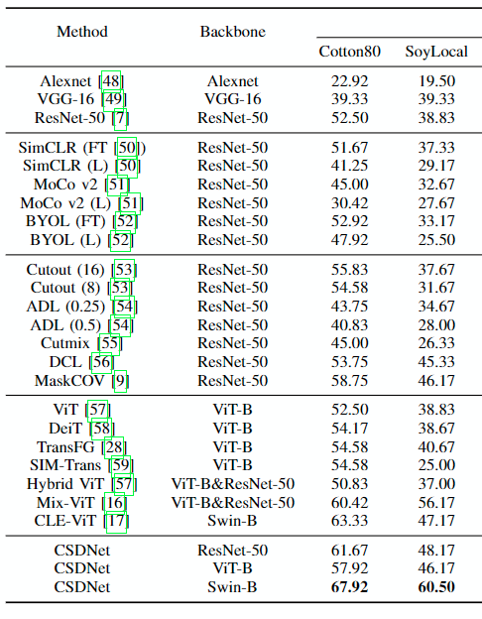
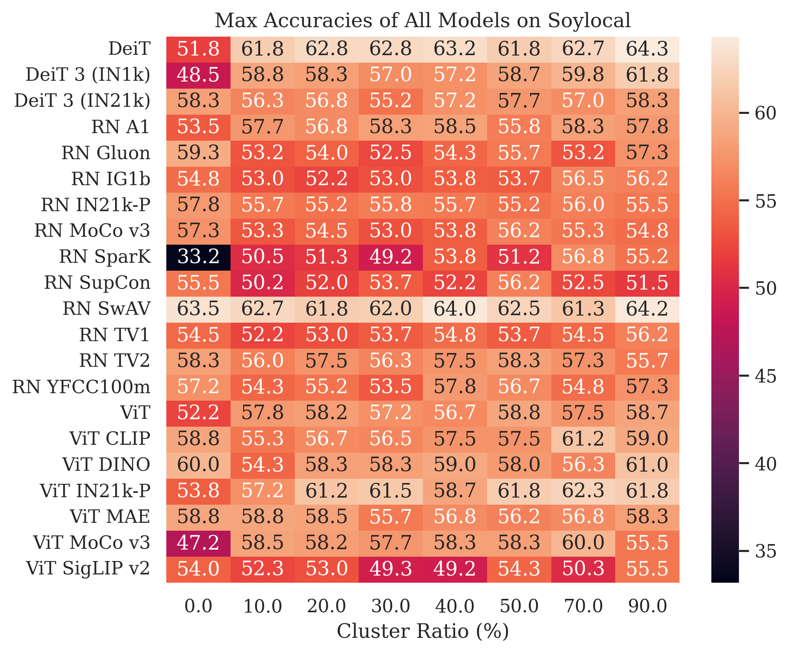
Soylocal heatmap
Best max accuracy is obtained by DeiT model and second next is by RN SwaV
Many models max accuracy drops rather than increases

Slide 12
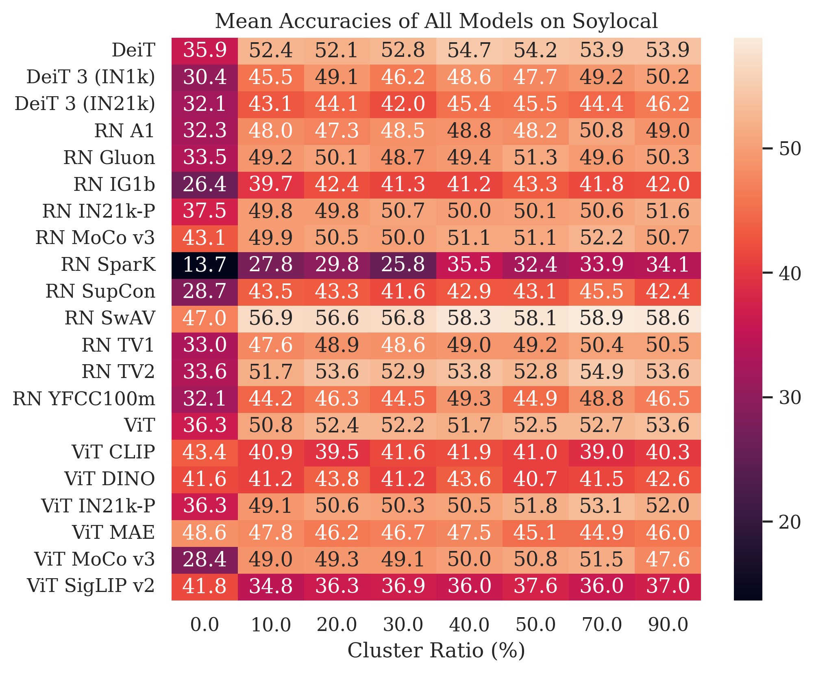
Soylocal heatmap
The mean accuracies show a clearer trend of improvement
Most model shows improvement over the baseline mean accuracies

Slide 13
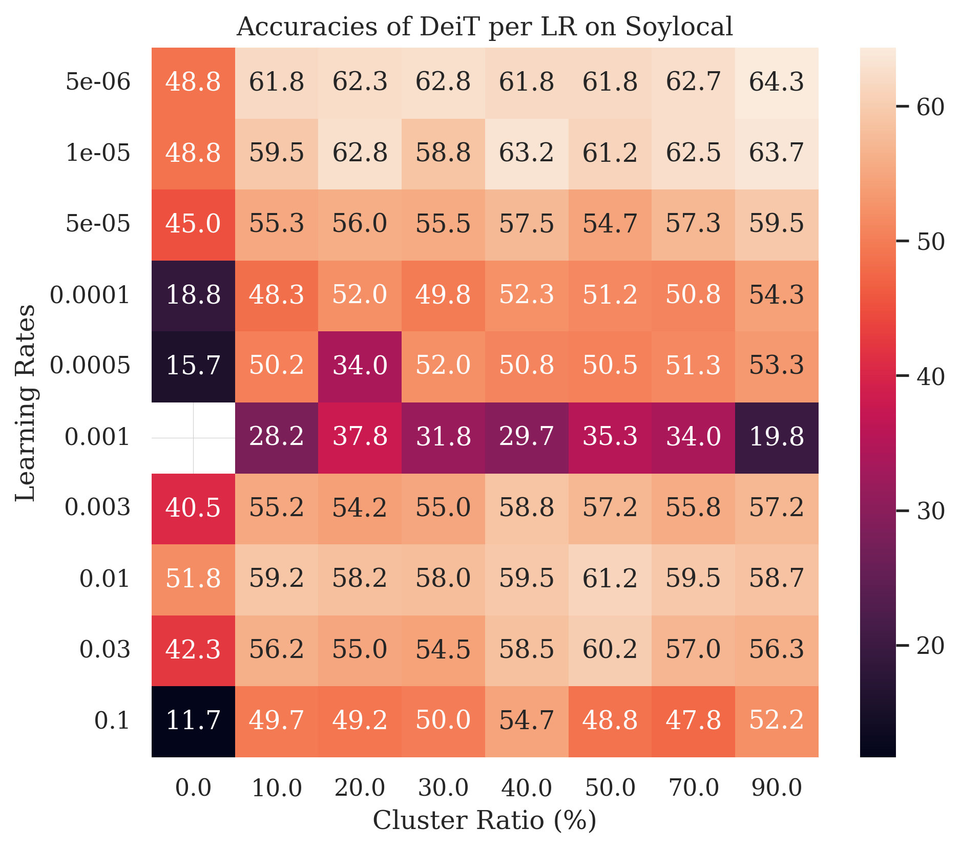
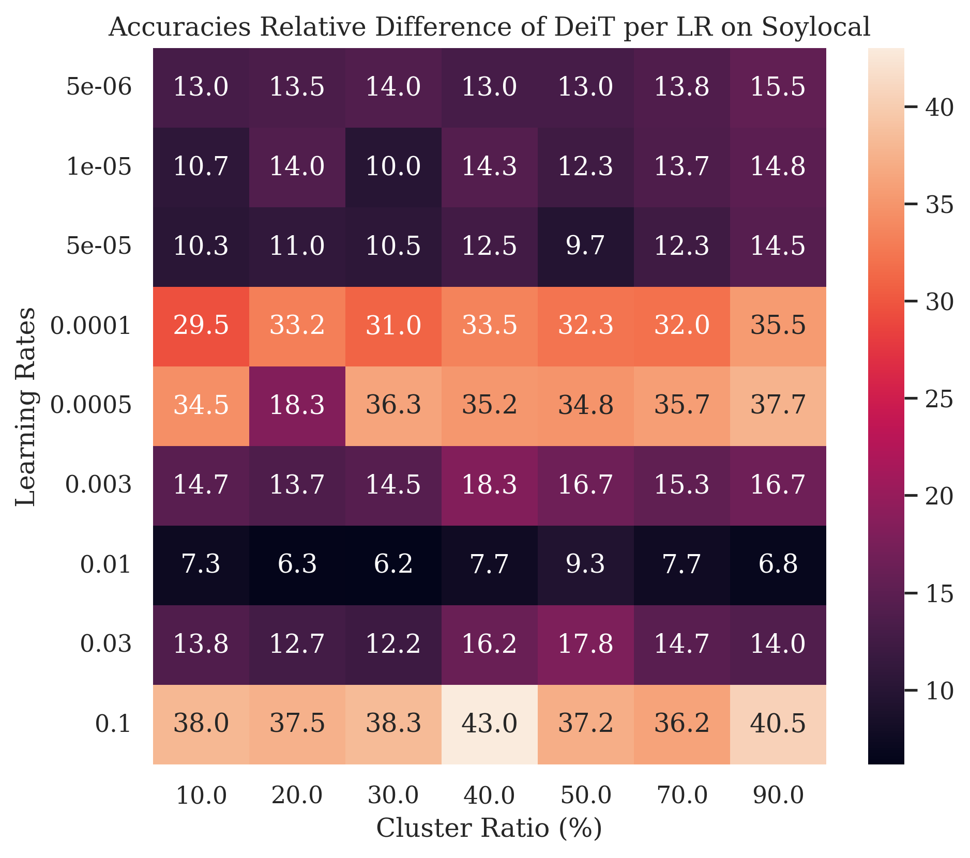
Soylocal heatmap
For DeiT, each LRs show consistent improvement over baseline
Though, the improvement varies

Slide 14
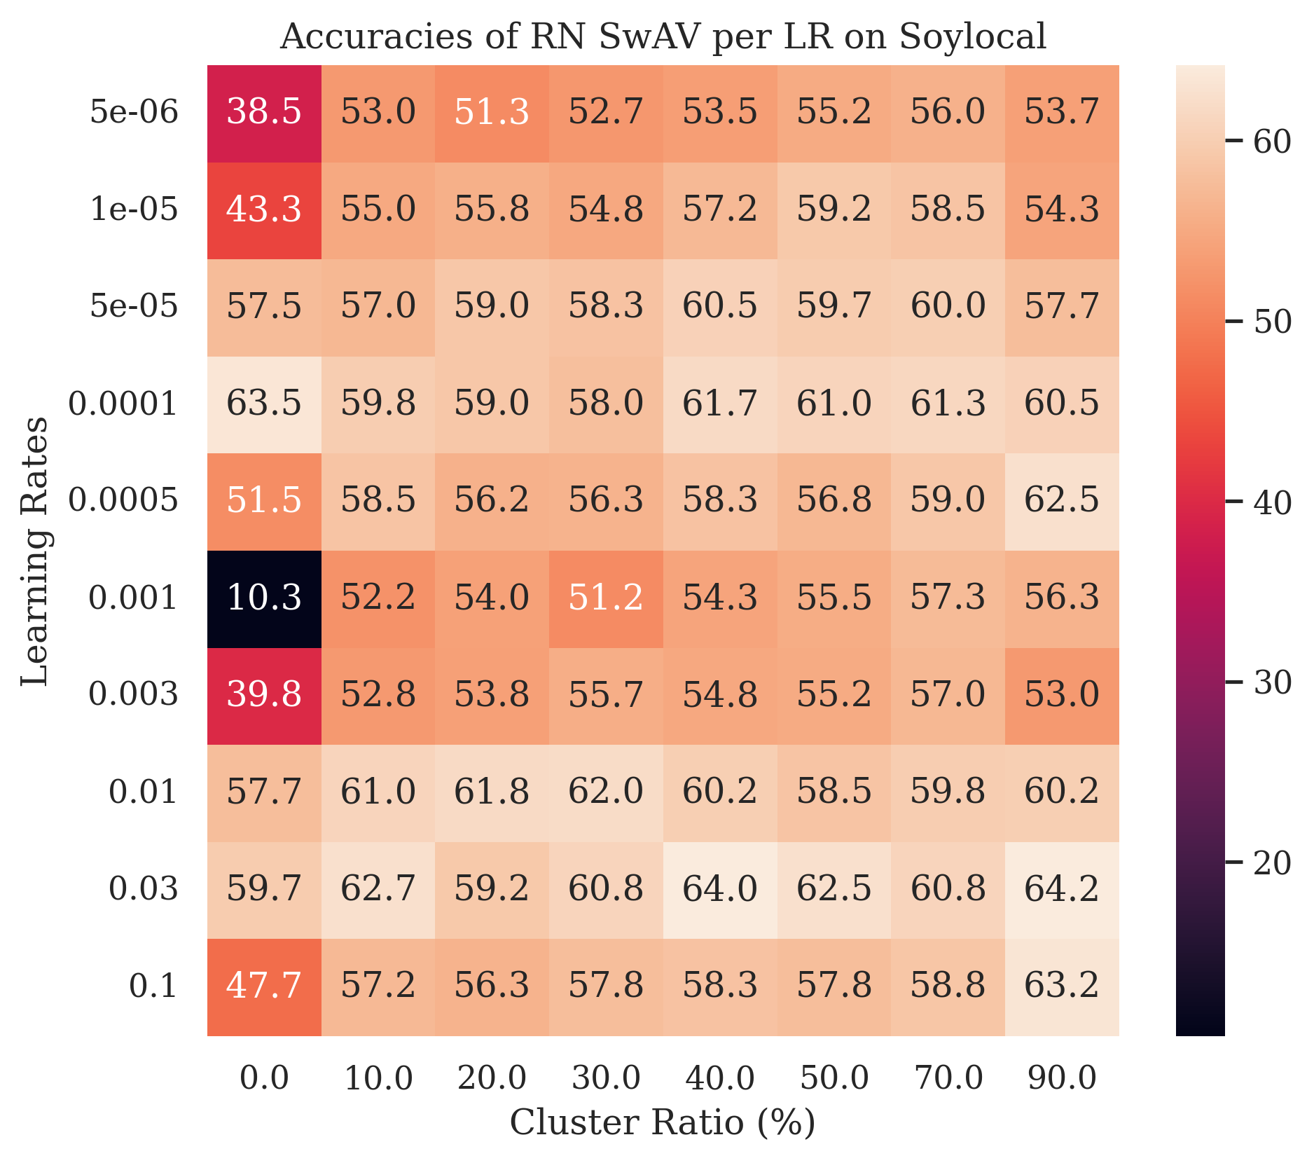
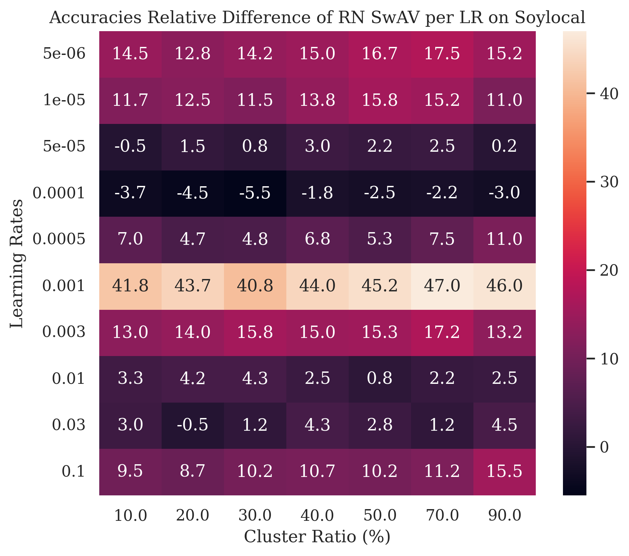
Soylocal heatmap
For SwaV, it mostly shows improvement over baseline other than LR = 0.0001
With the best being in 1 particular LR

Slide 15
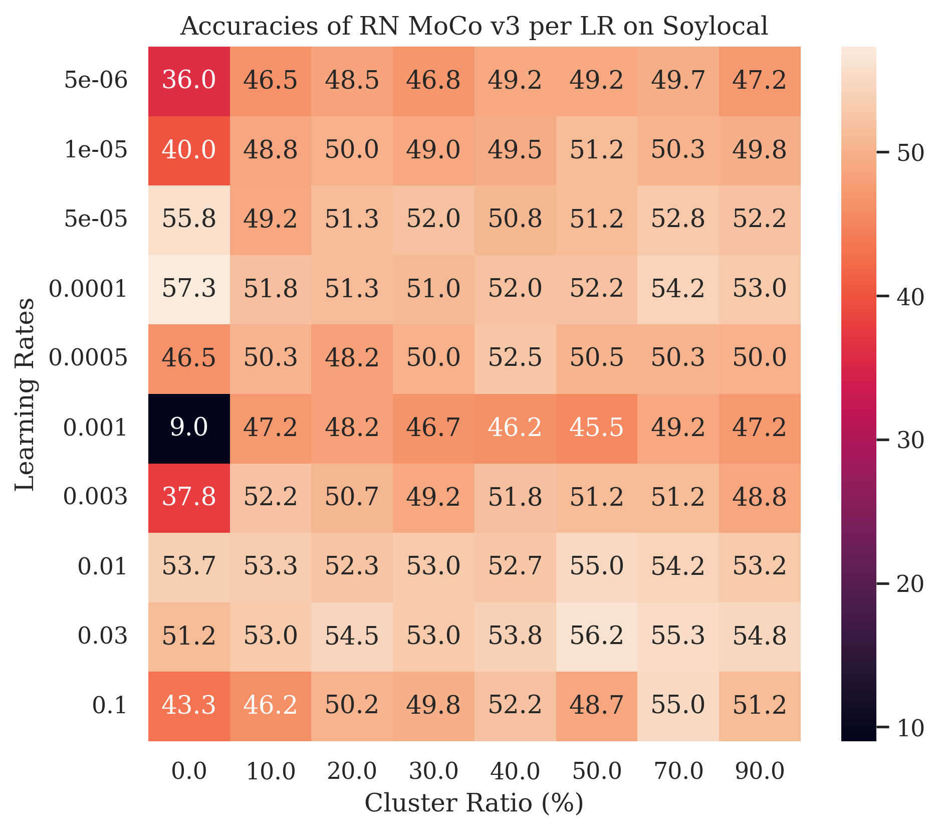
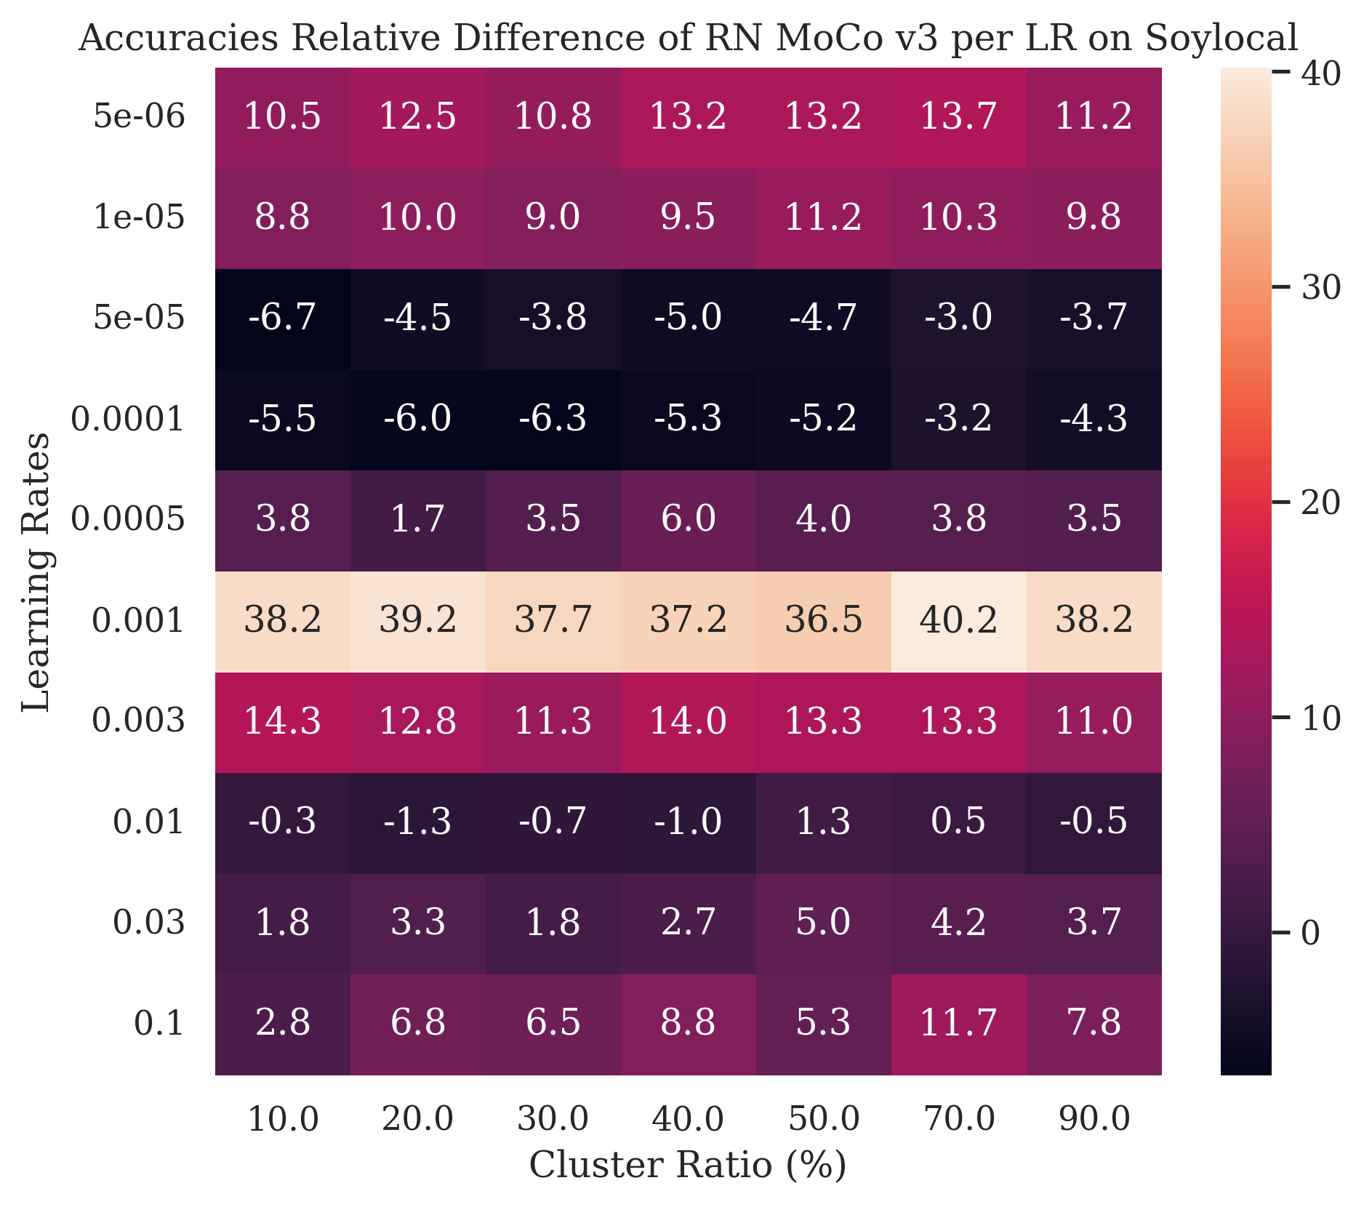
Soylocal heatmap
RN Mocov3, a contrastive learning model, best max accuracy is located in the baseline
However, pseudo-hierarchy is more robust for LR

